Slide 1


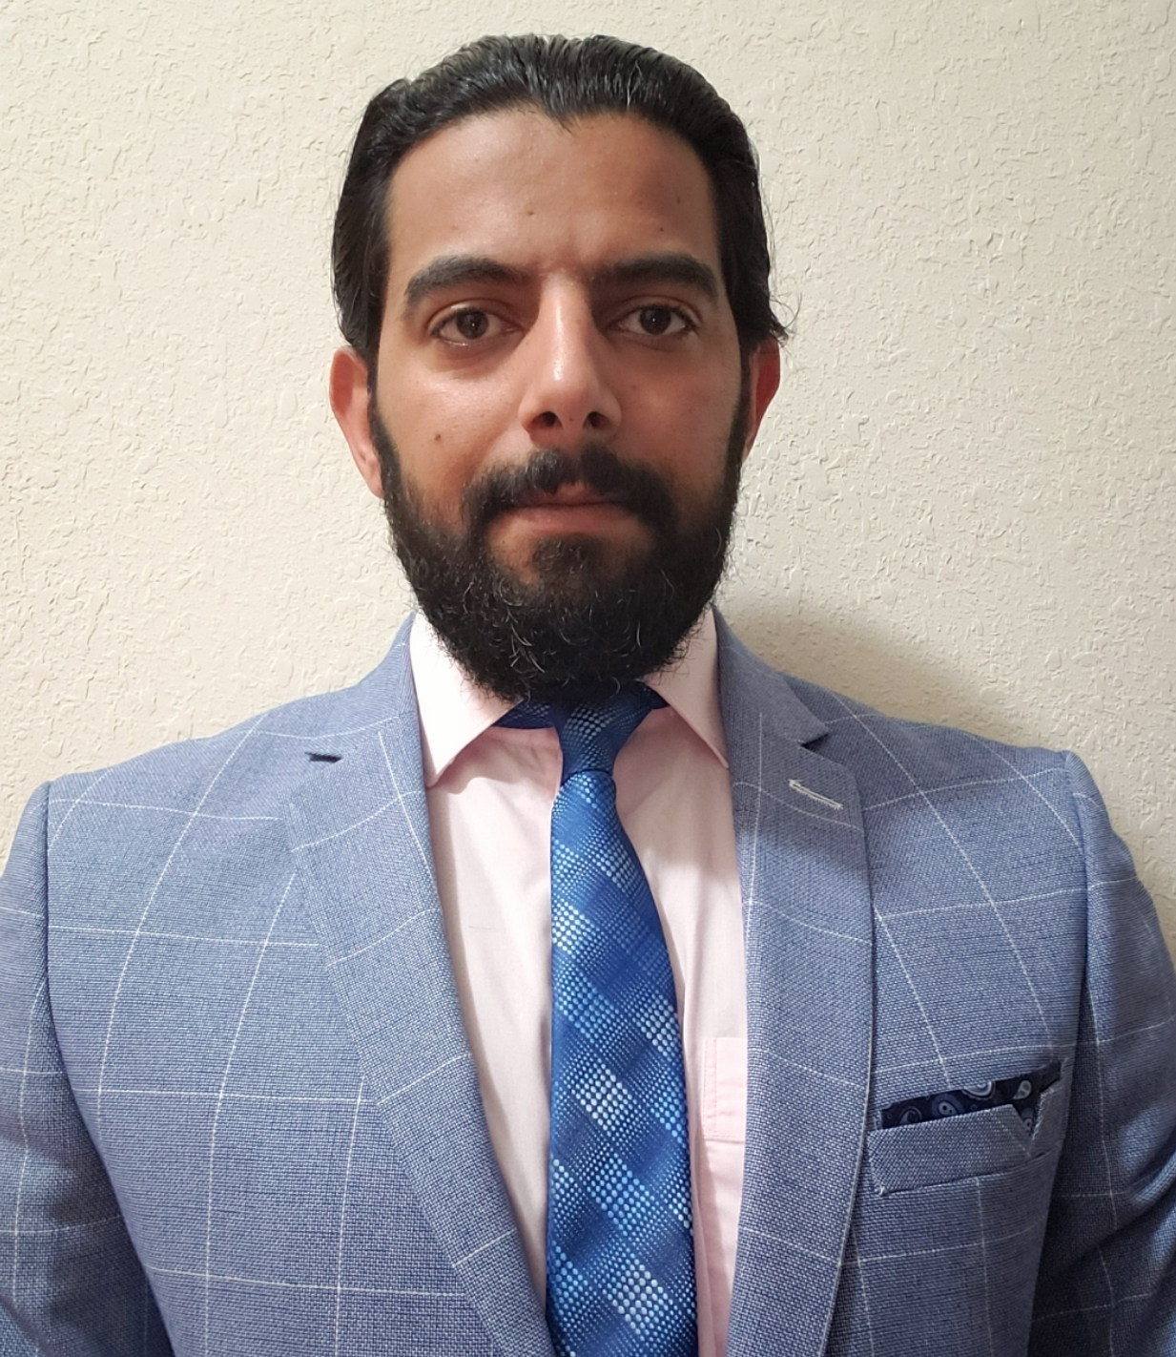
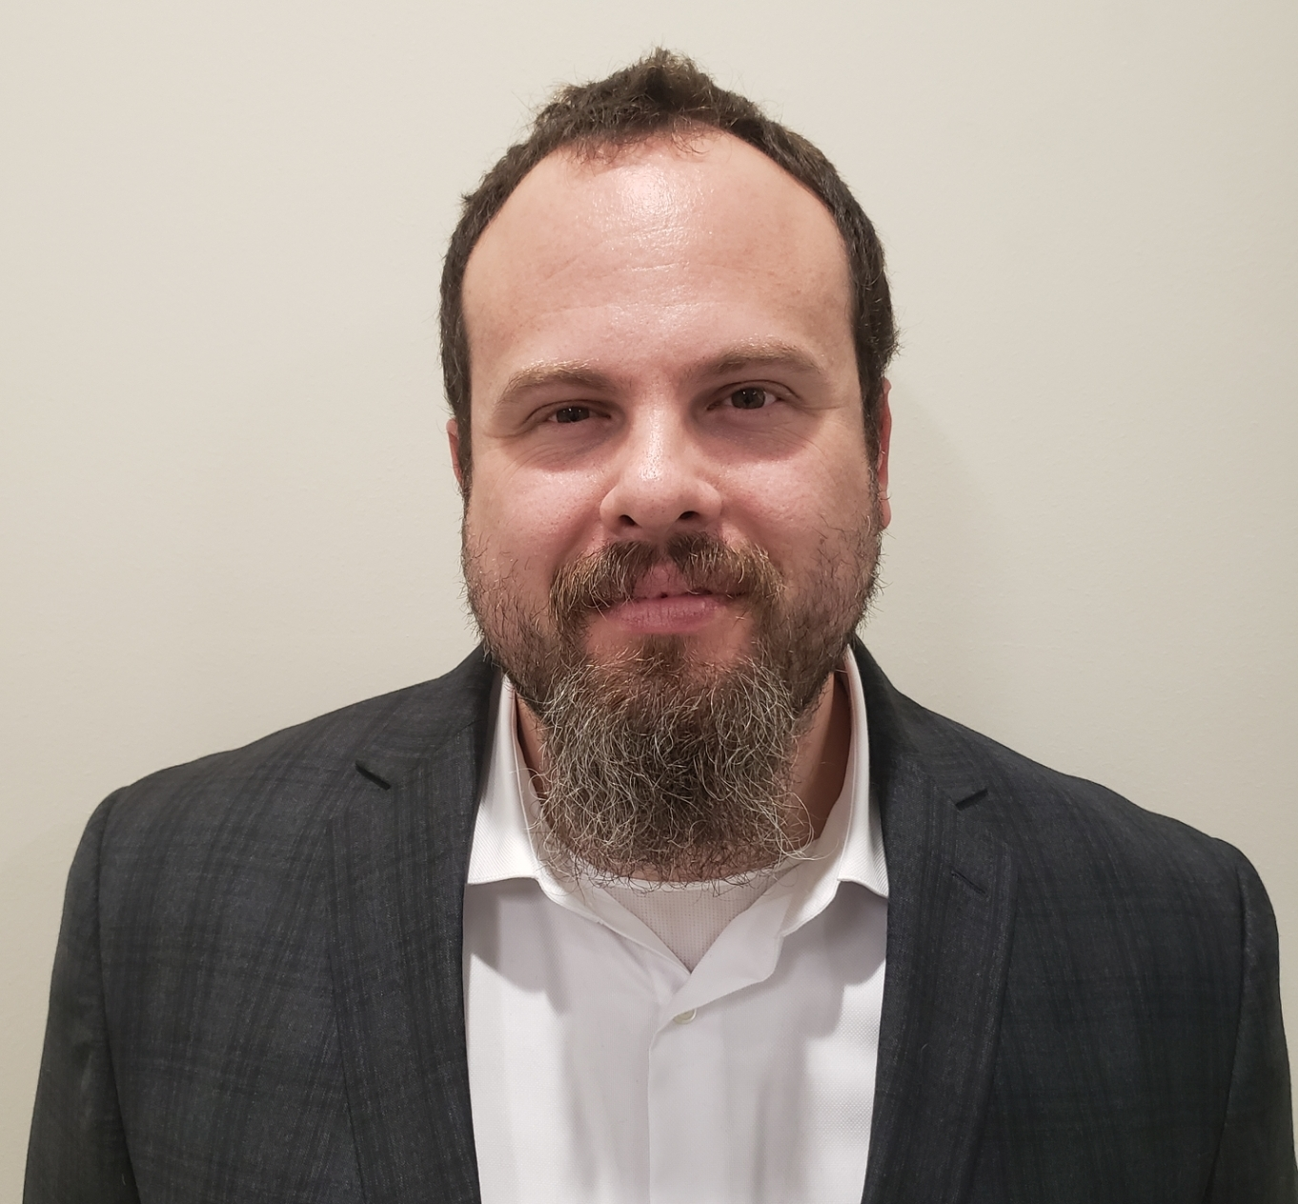
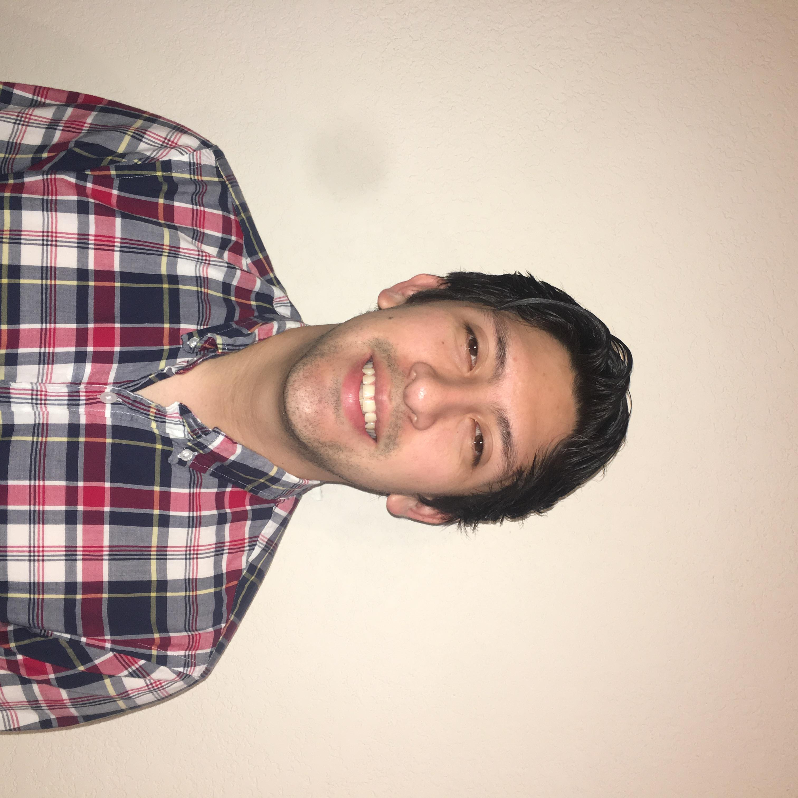
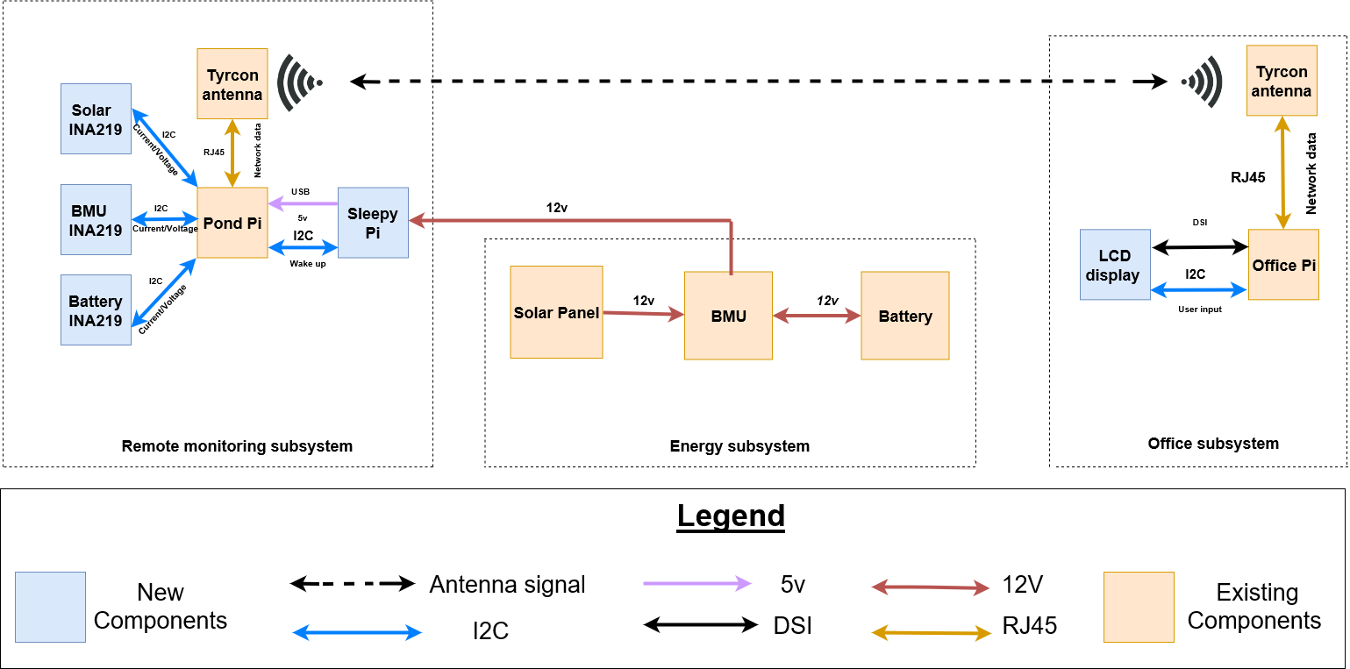
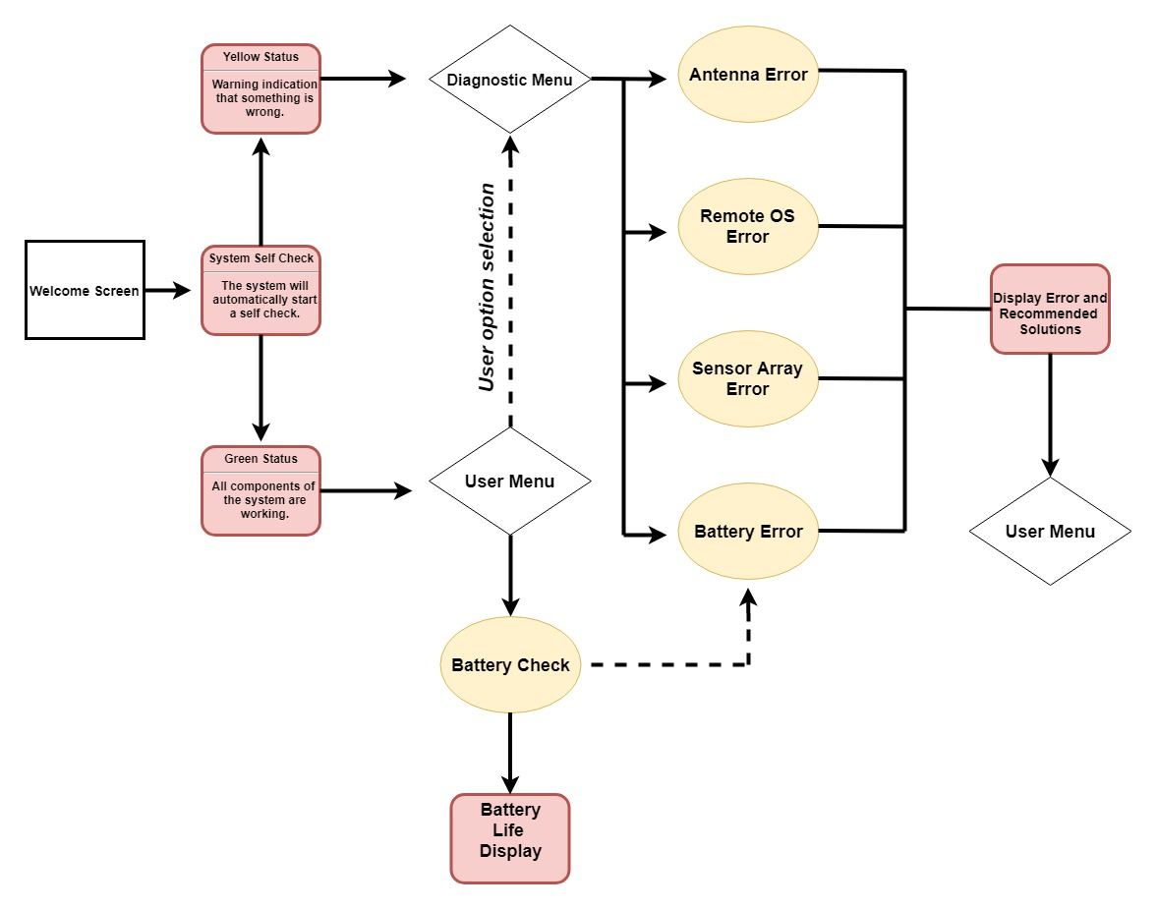
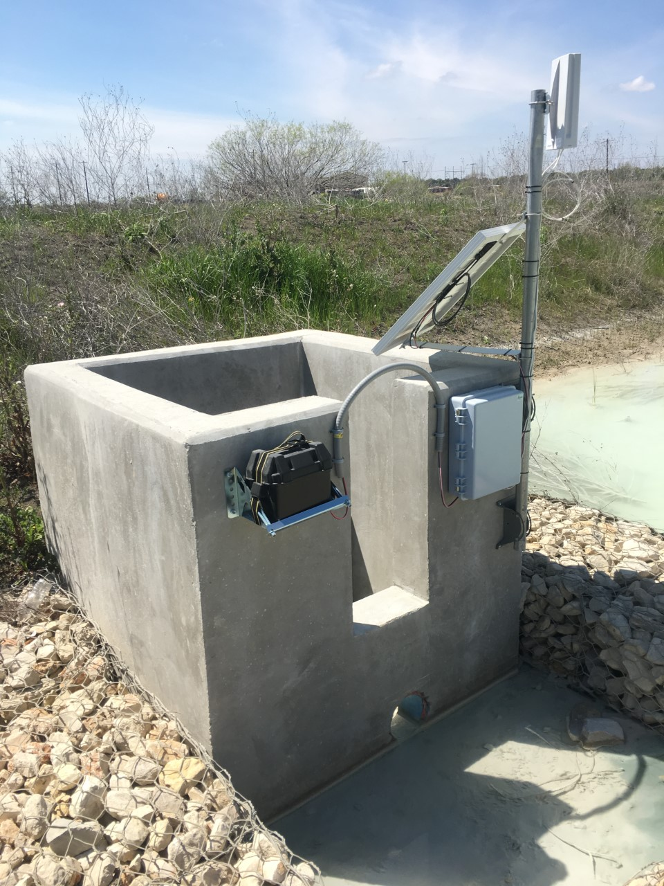
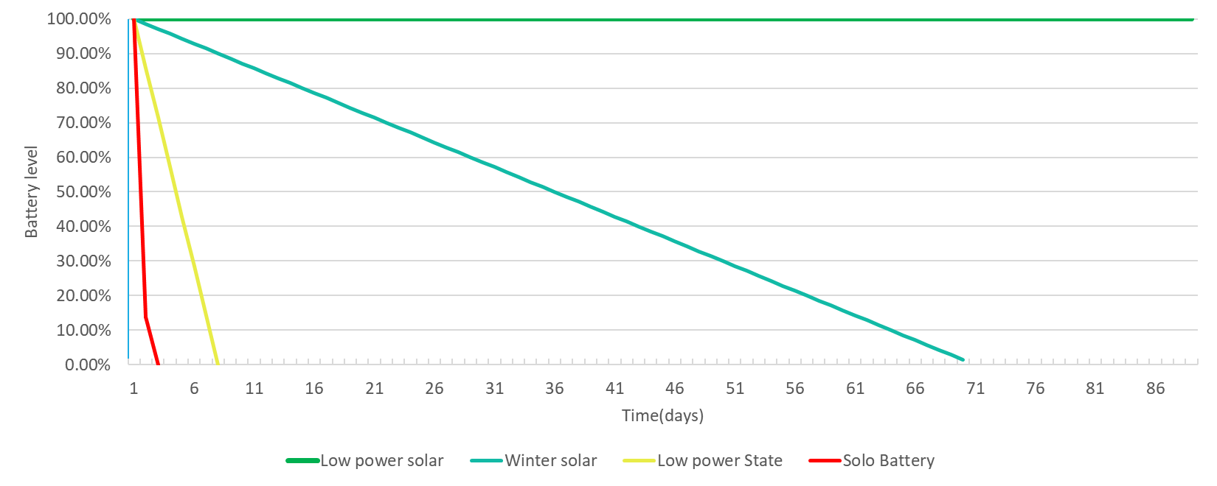
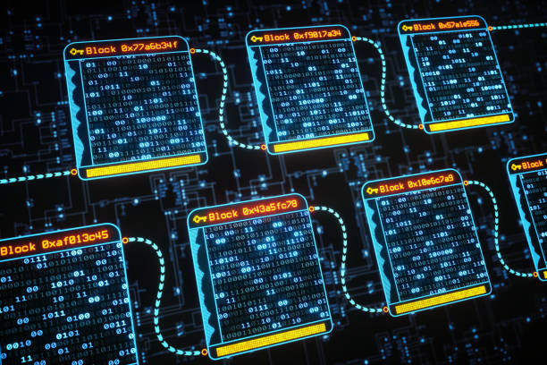
1.01- Ingram Readymix Inc.
Ahmed Al Qaysi, Nicholas Holleman, Andres Oliva
Sponsor: Mr. Charlie Tuttle
Starting from left to right:
The first subsystem is located at the water retention pond.
The second subsystem consist of the energy components.
The third subsystem is located at the office.
The end product will send notifications to the office with a time stamp to notify employees of an outflow event in a timely manner. This will be beneficial to the company to prevent any sort of possible future fines.
User Case
The Project
Project Overview
The Ingram Readymix project is an ongoing effort to develop an exhaust water monitoring system for a cement plant. This is a highly software-oriented project that will self-diagnose and analyze hardware components that make up the system at the facility’s water retention pond.
The user case flow chart is an example of what a general user would see when using the system. This will be an interactive graphical user interface (GUI) where the diagnostic operation will start.
Goals
Diagnostic of system errors and recommended solutions.
Create a private blockchain for log data assurance.
Power management and system analysis.
Power Management
Requirements:
5 days of power without solar.
Hardware needed:
SleepyPi and relays.
Data Log (Block Chain)
Stretch Goals
The TCEQ permit requires Ingram Readymix Inc. to maintain data log entries for a minimum of 3 years.
More block chain systems can be implemented due to its expandability.
This system will be able to detect corruption upon data entry.
Incorporate a modem to allow the user to interact with the system remotely.
Include sensors from other design projects for further analysis.

